Slide 1
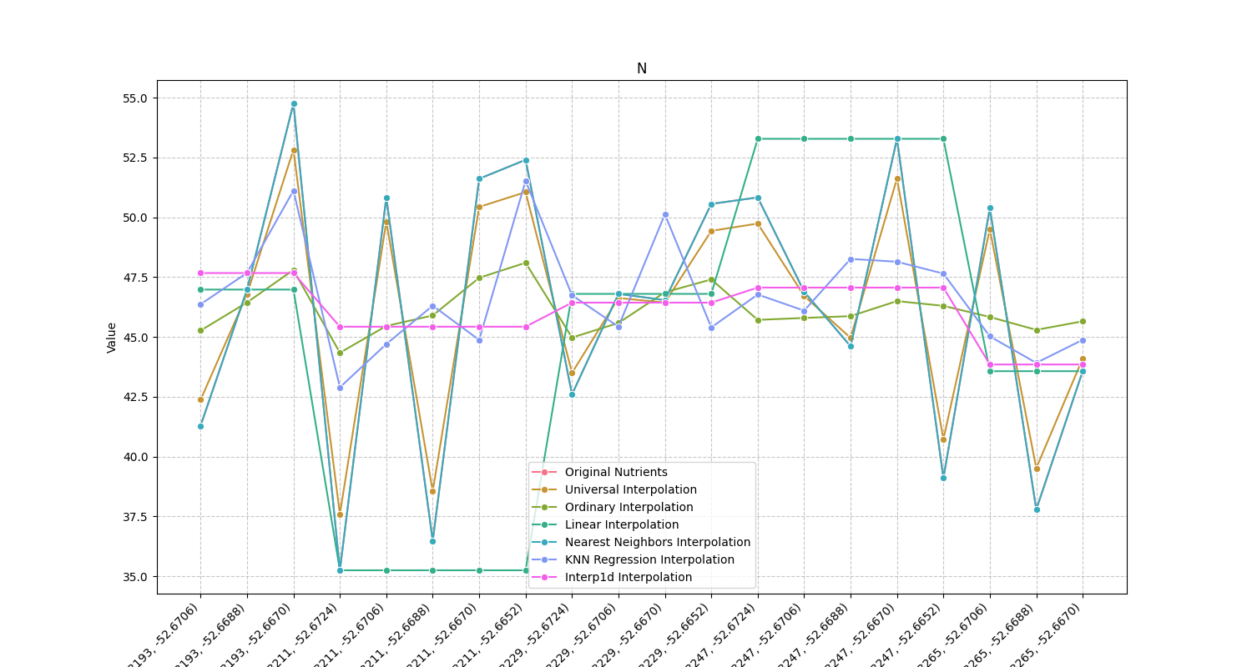
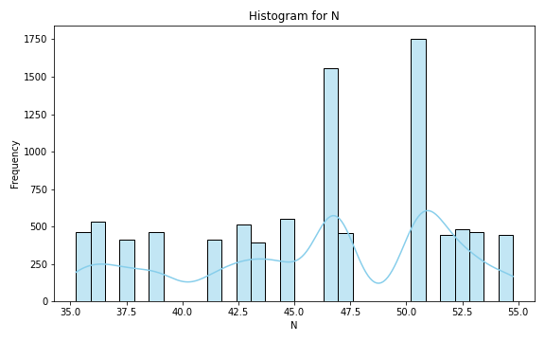
Analysis for column: N Model: UK
Interpolated Statistics:
mean 46.129557
std 1.394992
min 37.593214
25% 45.983997
50% 46.128000
75% 46.425943
80% 46.641169
85% 47.041881
90% 47.604057
95% 48.440180
99% 49.906209
Original Statistics:
mean 46.128000
std 5.867108
min 35.250000
25% 42.272500
50% 46.845000
75% 50.830000
80% 50.986000
85% 51.728500
90% 52.488000
95% 53.354000
99% 54.478800

Slide 2
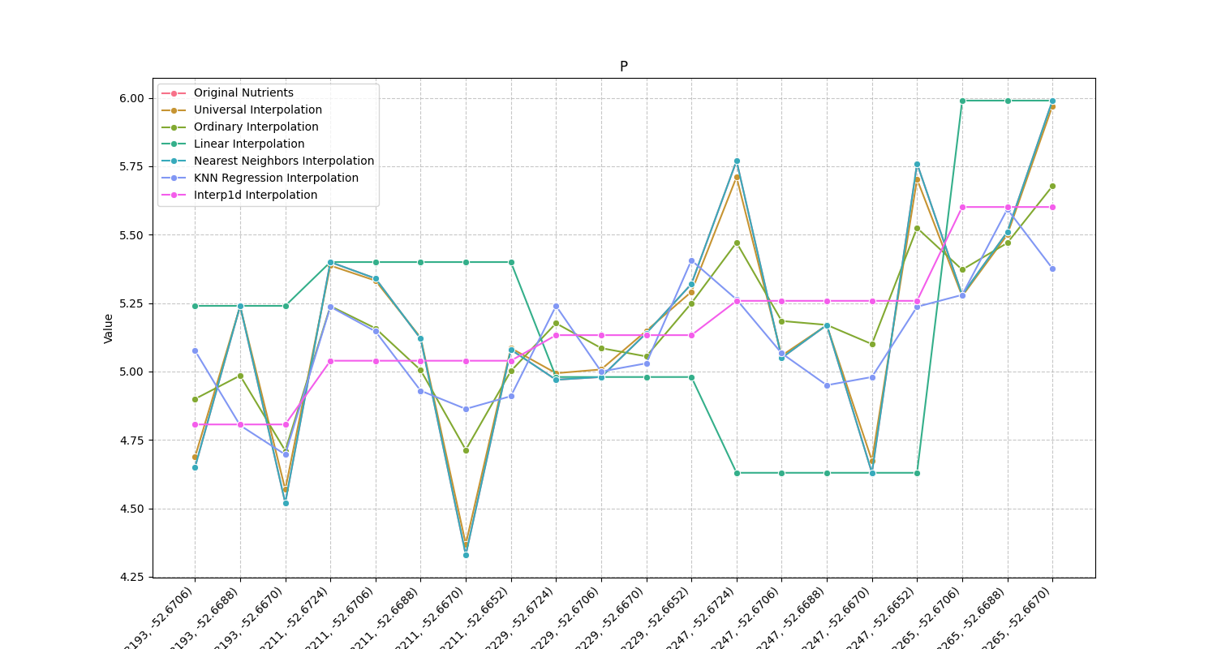
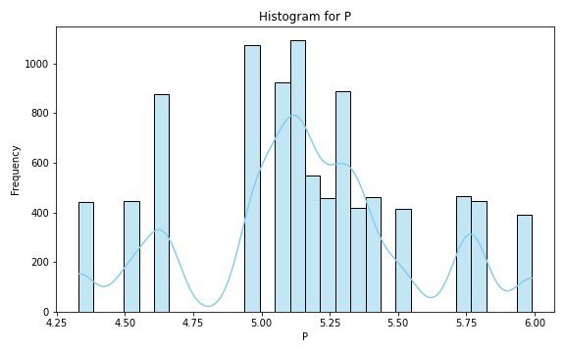
Analysis for column: P Model: UK
Interpolated Statistics:
mean 5.164558
std 0.081260
min 4.369581
25% 5.112819
50% 5.163542
75% 5.205809
80% 5.218745
85% 5.237141
90% 5.266497
95% 5.298942
99% 5.362797
Original Statistics:
mean 5.162500
std 0.423542
min 4.330000
25% 4.977500
50% 5.155000
75% 5.355000
80% 5.422000
85% 5.547500
90% 5.761000
95% 5.781000
99% 5.948200

Slide 3
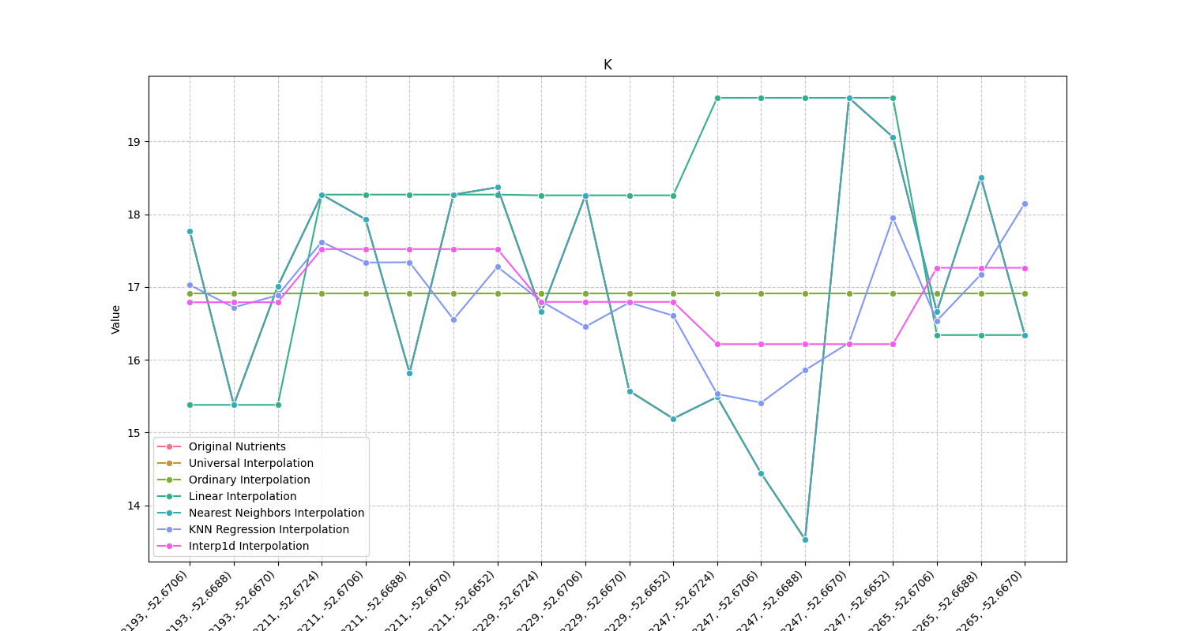
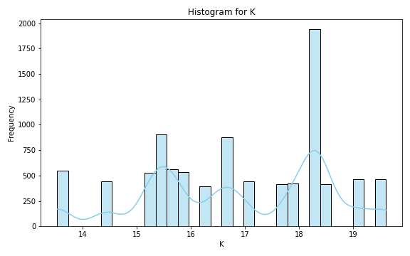
Analysis for column: K Model: UK
Interpolated Statistics:
mean 16.903391
std 0.928917
min 13.334734
25% 16.473186
50% 16.920012
75% 17.426495
80% 17.592166
85% 17.781686
90% 18.028941
95% 18.313380
99% 19.306567
Original Statistics:
mean 16.906500
std 1.656506
min 13.530000
25% 15.550000
50% 16.835000
75% 18.270000
80% 18.290000
85% 18.391000
90% 18.565000
95% 19.087000
99% 19.497400

Slide 4
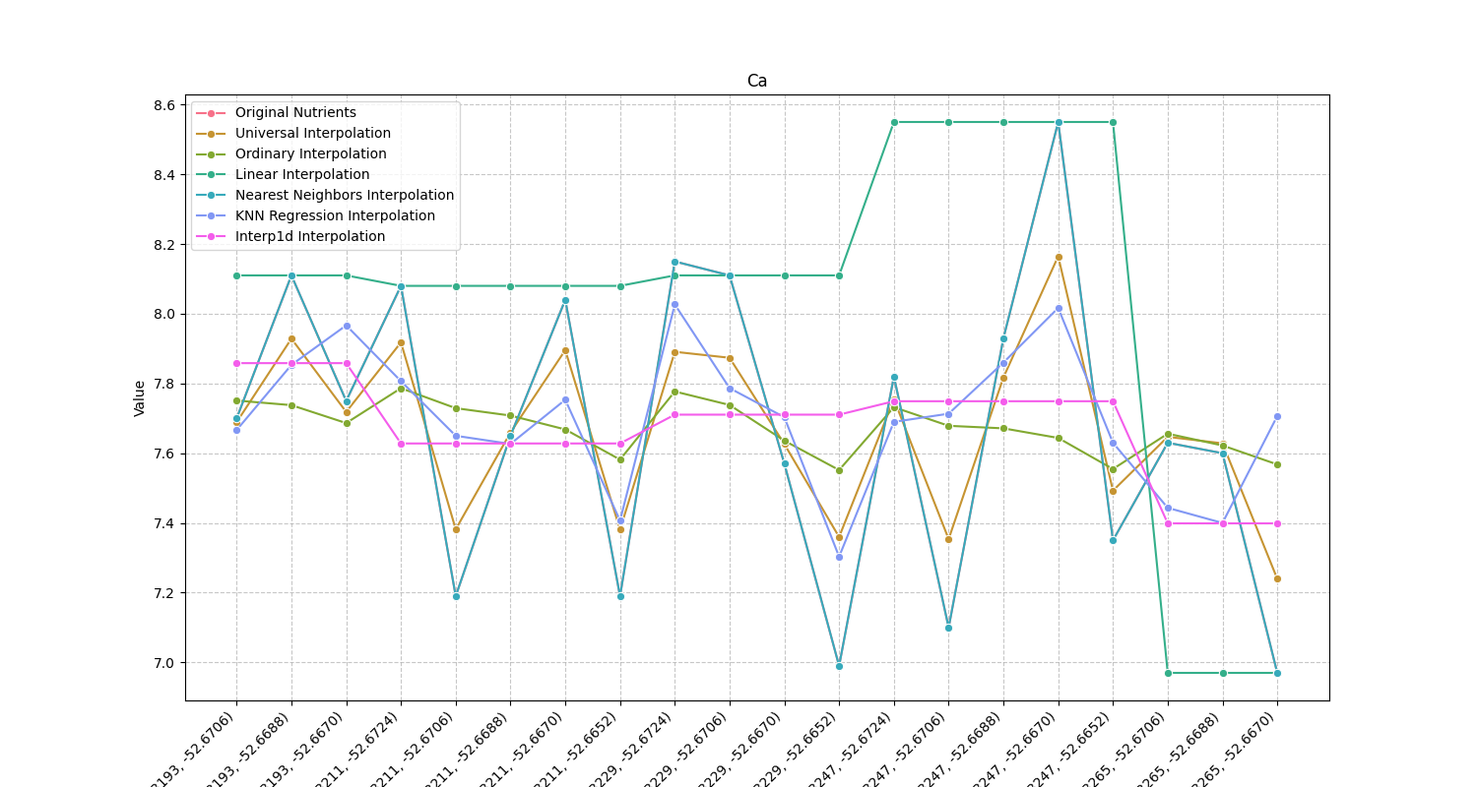
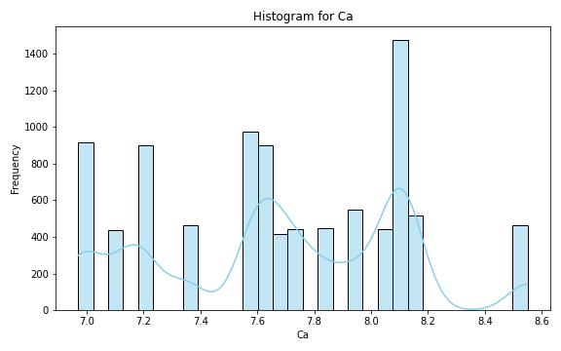
Analysis for column: Ca Model: UK
Interpolated Statistics:
mean 7.674000
std 0.012535
min 7.239756
25% 7.674000
50% 7.674000
75% 7.674000
80% 7.674000
85% 7.674000
90% 7.674000
95% 7.674000
99% 7.674794
Original Statistics:
mean 7.674000
std 0.438387
min 6.970000
25% 7.310000
50% 7.675000
75% 8.050000
80% 8.086000
85% 8.110000
90% 8.114000
95% 8.170000
99% 8.474000

Slide 5
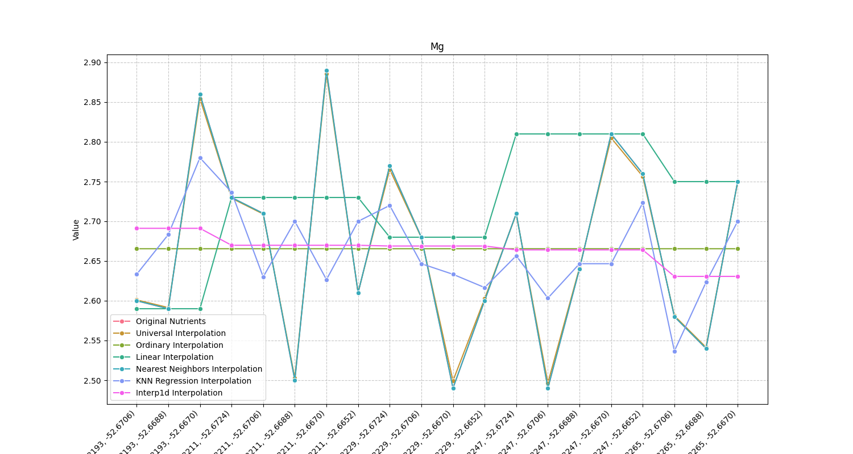
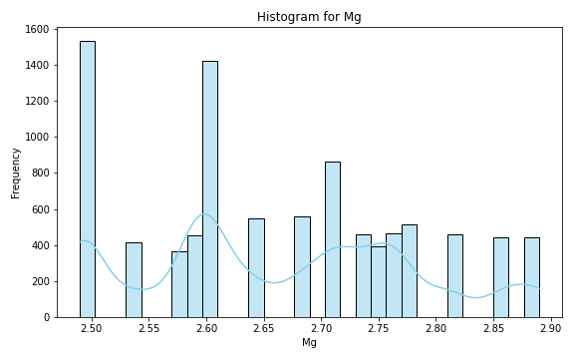
Analysis for column: Mg Model: UK
Interpolated Statistics:
mean 2.664283
std 0.046590
min 2.496498
25% 2.629490
50% 2.664055
75% 2.695719
80% 2.701562
85% 2.709133
90% 2.720530
95% 2.739805
99% 2.787824
Original Statistics:
mean 2.665500
std 0.120196
min 2.490000
25% 2.587500
50% 2.660000
75% 2.752500
80% 2.762000
85% 2.776000
90% 2.815000
95% 2.861500
99% 2.884300

Slide 6
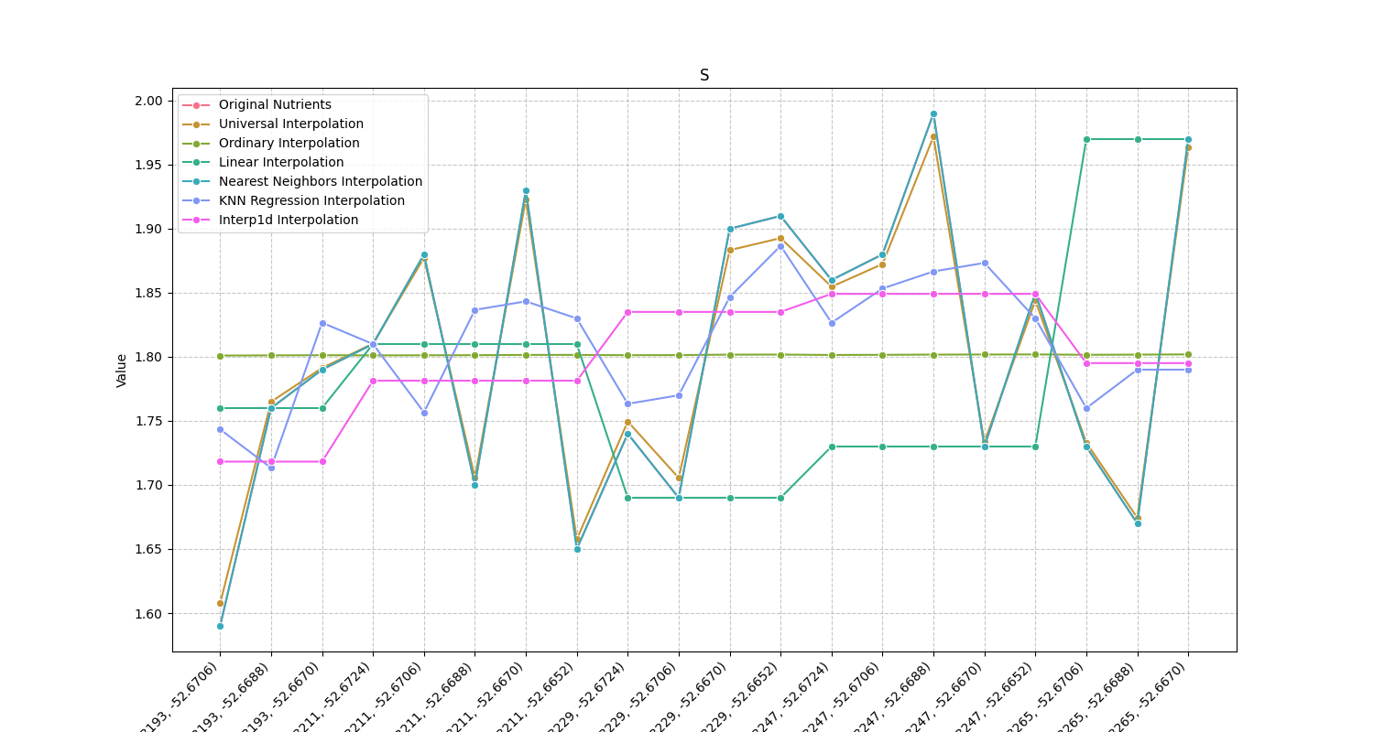
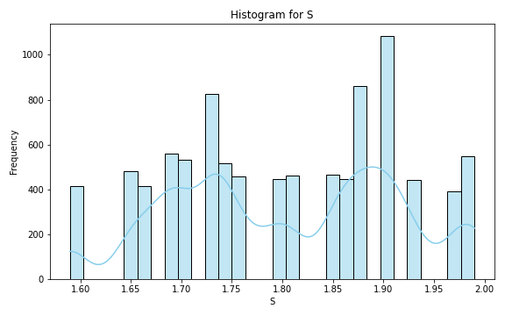
Analysis for column: S Model: UK
Interpolated Statistics:
mean 1.800907
std 0.023689
min 1.607632
25% 1.785178
50% 1.801534
75% 1.814232
80% 1.817890
85% 1.822140
90% 1.829576
95% 1.839413
99% 1.858625
Original Statistics:
mean 1.801500
std 0.113243
min 1.590000
25% 1.722500
50% 1.800000
75% 1.885000
80% 1.902000
85% 1.913000
90% 1.934000
95% 1.971000
99% 1.986200

Slide 7
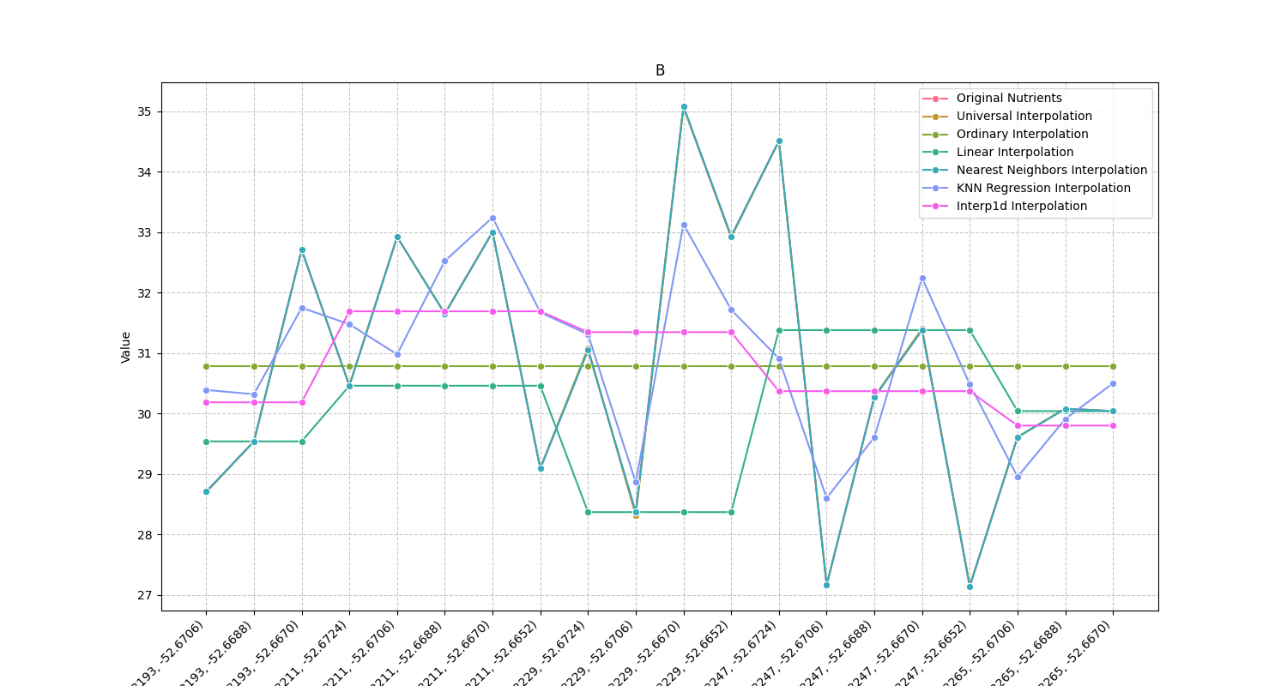
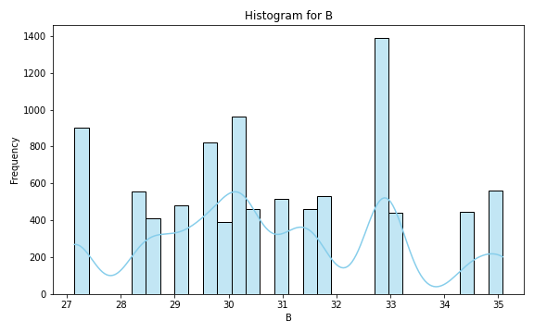
Analysis for column: B Model: UK
Interpolated Statistics:
mean 30.817540
std 1.581753
min 27.074507
25% 29.831679
50% 30.631185
75% 31.876954
80% 32.202550
85% 32.542232
90% 32.881824
95% 33.654053
99% 34.612115
Original Statistics:
mean 30.78550
std 2.23589
min 27.14000
25% 29.42750
50% 30.36500
75% 32.76250
80% 32.92200
85% 32.94050
90% 33.15100
95% 34.53850
99% 34.97170

Slide 8
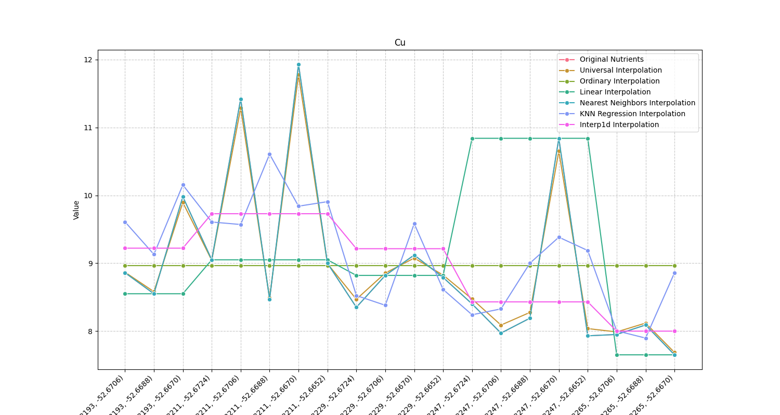
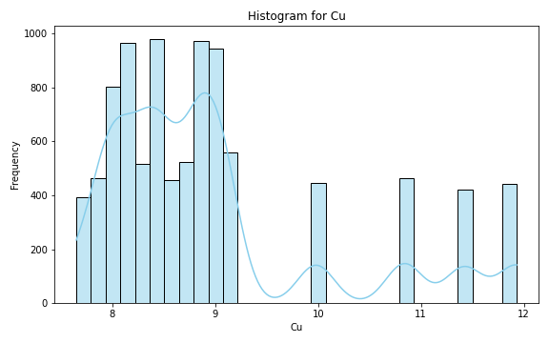
Analysis for column: Cu Model: UK
Interpolated Statistics:
mean 8.963498
std 0.213102
min 7.684603
25% 8.836255
50% 8.957674
75% 9.094436
80% 9.125820
85% 9.173640
90% 9.215656
95% 9.265068
99% 9.378447
Original Statistics:
mean 8.968000
std 1.186785
min 7.650000
25% 8.165000
50% 8.670000
75% 9.067500
80% 9.292000
85% 10.109000
90% 10.898000
95% 11.445500
99% 11.833100

Slide 9
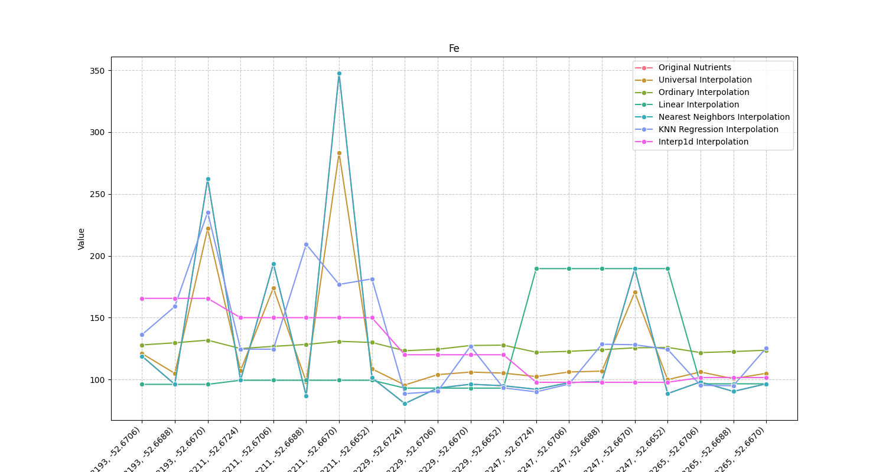
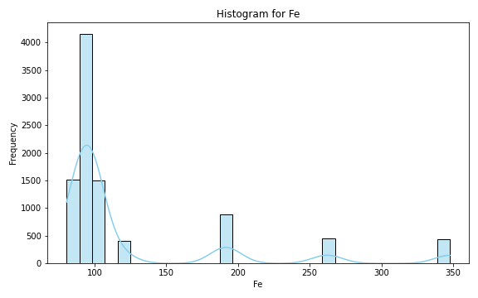
Analysis for column: Fe Model: UK
Interpolated Statistics:
mean 126.079494
std 4.765311
min 95.537404
25% 126.079498
50% 126.079500
75% 126.079500
80% 126.079500
85% 126.079500
90% 126.079500
95% 126.079663
99% 132.169980
Original Statistics:
mean 126.079500
std 69.663061
min 80.520000
25% 92.780000
50% 96.960000
75% 105.790000
80% 133.026000
85% 190.253000
90% 200.522000
95% 266.466000
99% 331.461200

Slide 10
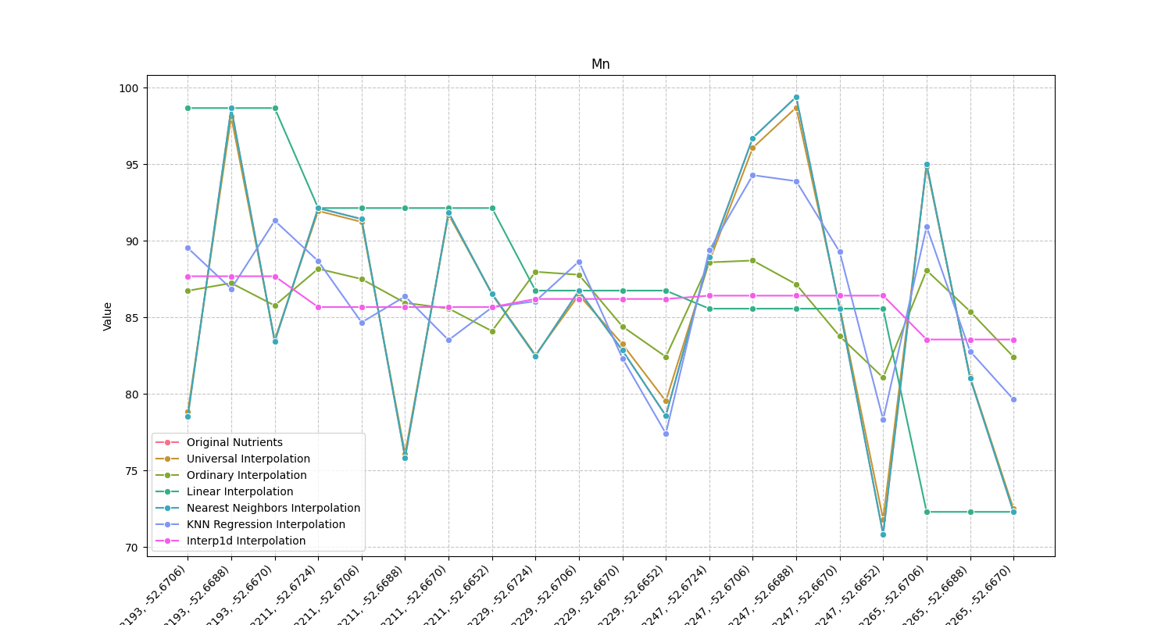
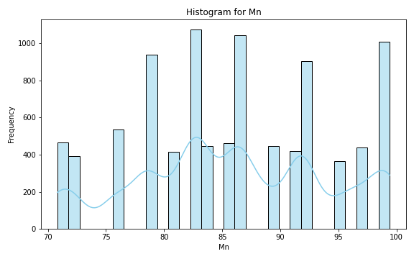
Analysis for column: Mn Model: UK
Interpolated Statistics:
mean 85.927137
std 2.512561
min 71.821018
25% 84.551400
50% 85.803523
75% 87.377968
80% 87.668396
85% 87.991466
90% 88.652851
95% 89.973029
99% 93.346280
Original Statistics:
mean 85.944000
std 8.375733
min 70.830000
25% 80.432500
50% 86.045000
75% 91.930000
80% 92.716000
85% 95.275000
90% 96.915000
95% 98.706500
99% 99.261300

Slide 11
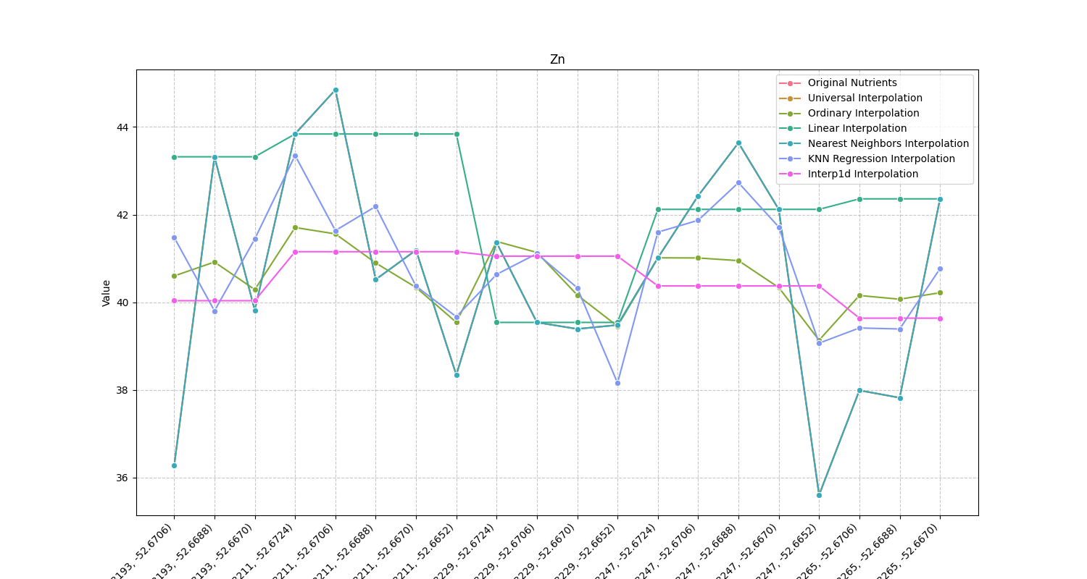
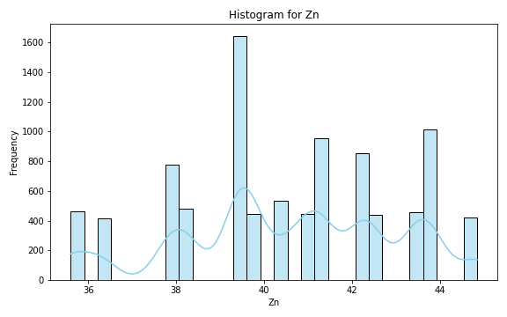
Analysis for column: Zn Model: UK
Interpolated Statistics:
mean 40.517394
std 1.464094
min 35.568909
25% 39.788228
50% 40.500023
75% 41.220737
80% 41.502031
85% 41.916997
90% 42.406411
95% 43.104052
99% 44.346195
Original Statistics:
mean 40.54450
std 2.54272
min 35.60000
25% 39.12750
50% 40.76500
75% 42.37750
80% 42.60800
85% 43.36800
90% 43.66000
95% 43.89050
99% 44.65810

Slide 12
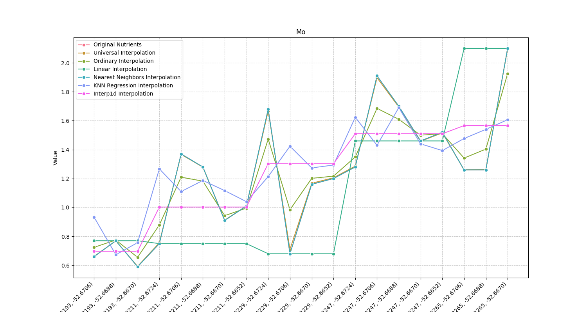
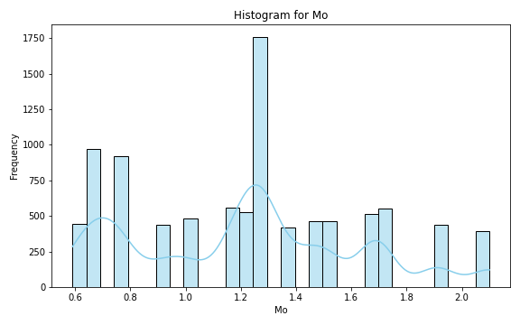
Analysis for column: Mo Model: UK
Interpolated Statistics:
mean 1.226549
std 0.298864
min 0.592736
25% 1.001353
50% 1.233893
75% 1.439275
80% 1.492351
85% 1.555561
90% 1.620378
95% 1.704157
99% 1.908306
Original Statistics:
mean 1.2275
std 0.4256
min 0.5900
25% 0.8750
50% 1.2600
75% 1.4750
80% 1.5520
85% 1.6830
90% 1.7210
95% 1.9195
99% 2.0639

Slide 13
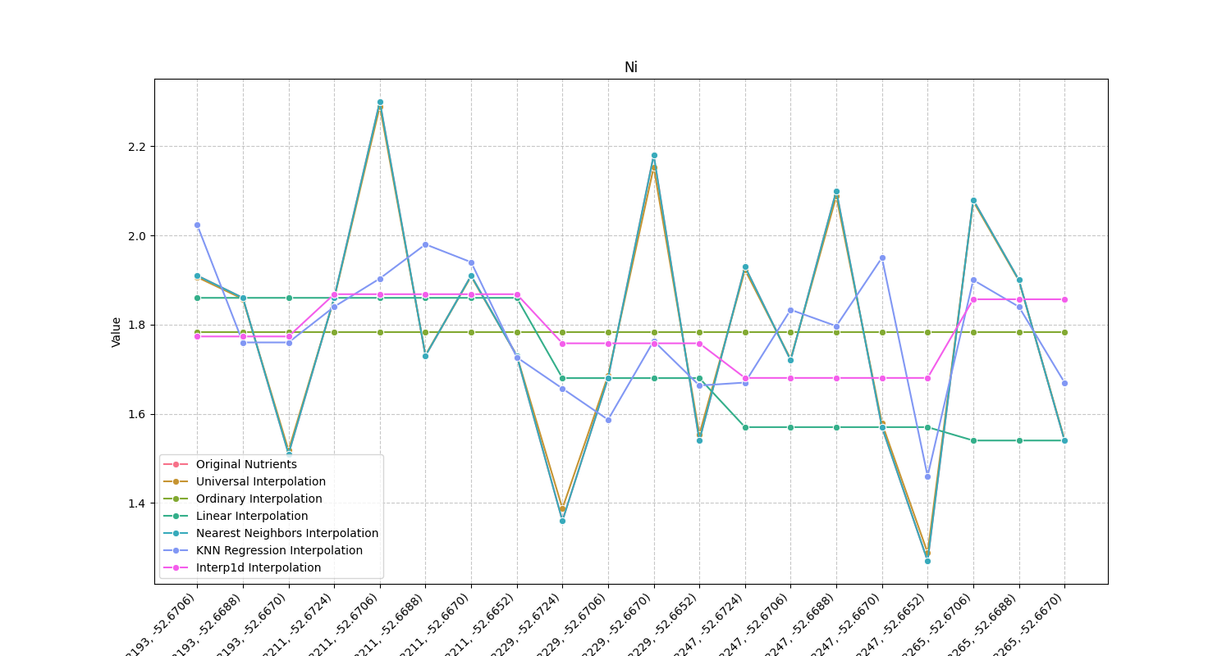
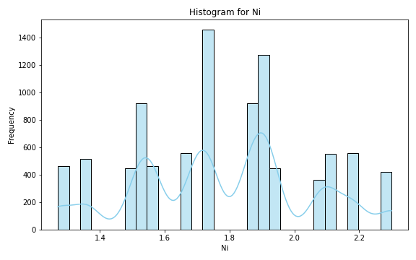
Analysis for column: Ni Model: UK
Interpolated Statistics:
mean 1.784647
std 0.094502
min 1.288344
25% 1.734441
50% 1.792158
75% 1.838204
80% 1.850079
85% 1.862259
90% 1.882324
95% 1.926747
99% 2.040397
Original Statistics:
mean 1.784000
std 0.270796
min 1.270000
25% 1.562500
50% 1.795000
75% 1.915000
80% 1.960000
85% 2.083000
90% 2.108000
95% 2.186000
99% 2.277200

Slide 14
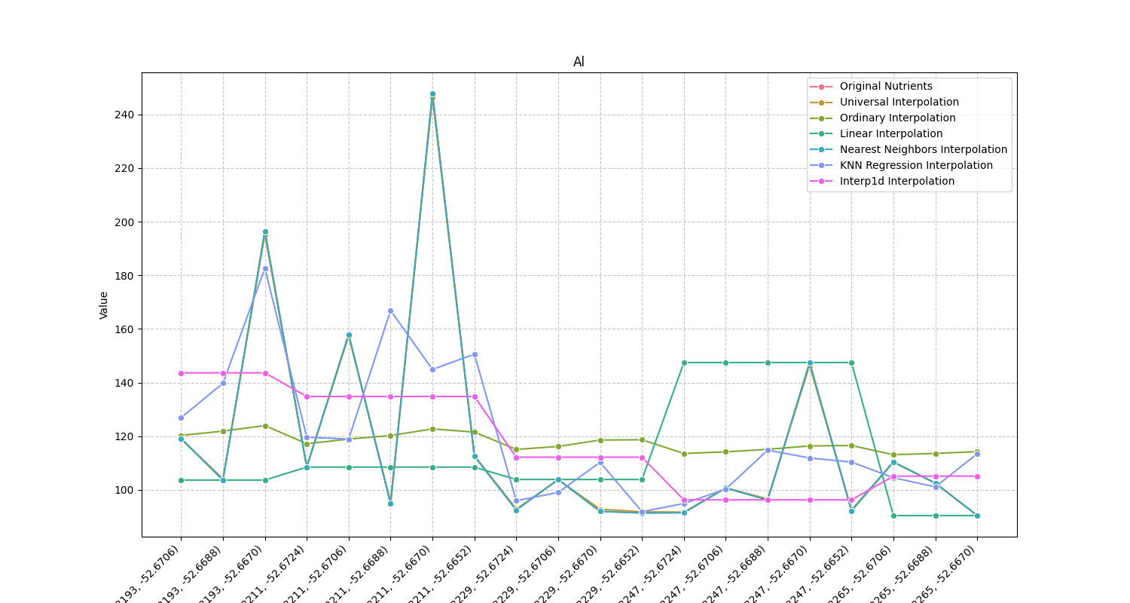
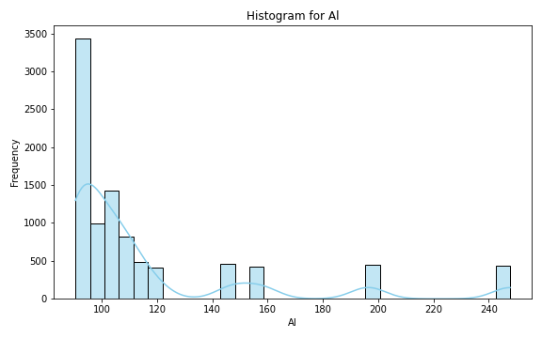
Analysis for column: Al Model: UK
Interpolated Statistics:
mean 117.194358
std 23.297258
min 90.483079
25% 102.781437
50% 109.195532
75% 121.343528
80% 126.471709
85% 134.566580
90% 148.771654
95% 173.414327
99% 202.024481
Original Statistics:
mean 117.593500
std 40.882932
min 90.400000
25% 92.415000
50% 103.070000
75% 114.200000
80% 124.788000
85% 149.036500
90% 161.815000
95% 198.988000
99% 238.021600

Slide 15
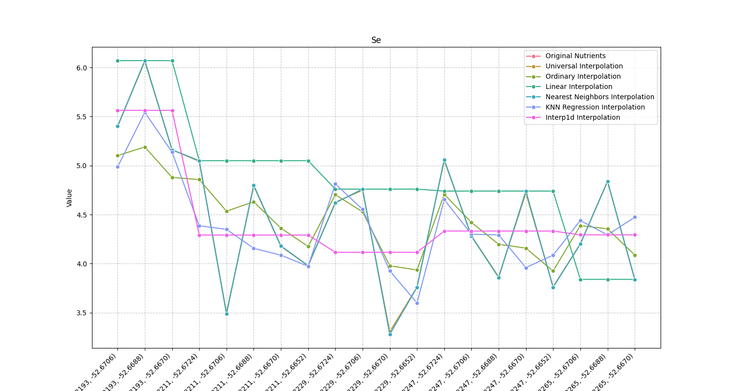
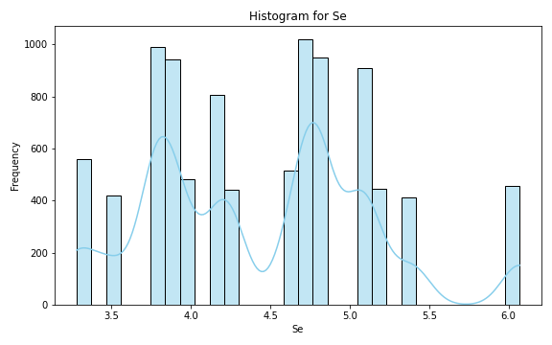
Analysis for column: Se Model: UK
Interpolated Statistics:
mean 4.436187
std 0.495366
min 3.307964
25% 4.044775
50% 4.365290
75% 4.742245
80% 4.820737
85% 4.921954
90% 5.065679
95% 5.437353
99% 5.769893
Original Statistics:
mean 4.456500
std 0.710599
min 3.280000
25% 3.855000
50% 4.450000
75% 4.892500
80% 5.052000
85% 5.075000
90% 5.184000
95% 5.433500
99% 5.942700

Slide 16
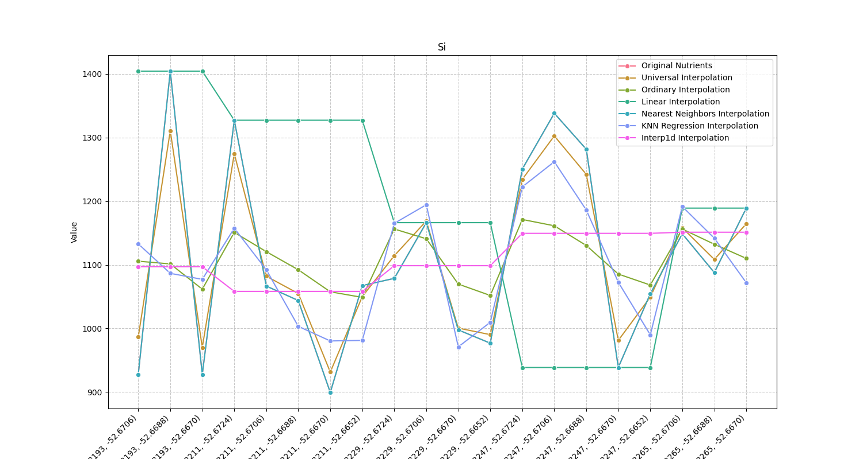
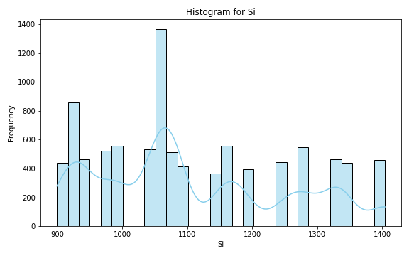
Analysis for column: Si Model: UK
Interpolated Statistics:
mean 1107.927844
std 83.554481
min 931.443482
25% 1035.166803
50% 1112.281733
75% 1173.010869
80% 1189.523985
85% 1205.894129
90% 1222.758239
95% 1242.094203
99% 1272.211207
Original Statistics:
mean 1108.621500
std 150.260489
min 899.420000
25% 992.460000
50% 1073.010000
75% 1204.430000
80% 1256.702000
85% 1288.428500
90% 1328.269000
95% 1341.381000
99% 1391.708200

Slide 17
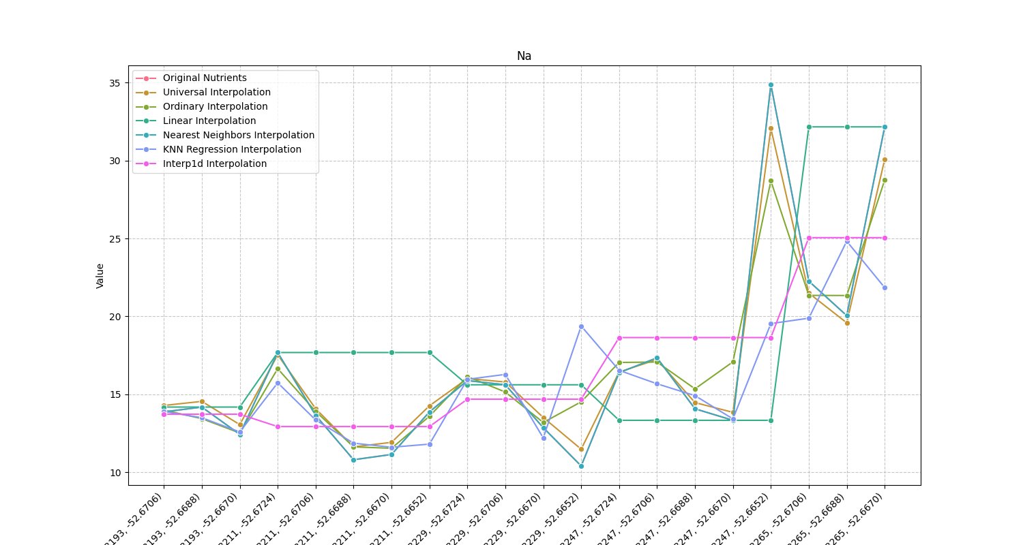
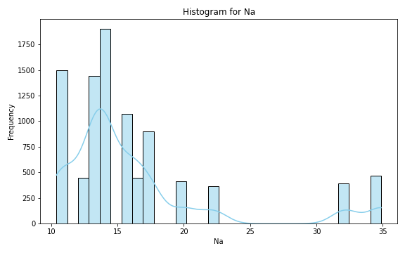
Analysis for column: Na Model: UK
Interpolated Statistics:
mean 16.628381
std 1.670875
min 11.476982
25% 16.139481
50% 16.575910
75% 16.642511
80% 16.734826
85% 16.928792
90% 17.400503
95% 19.098376
99% 24.817911
Original Statistics:
mean 16.642500
std 6.502053
min 10.400000
25% 13.212500
50% 14.125000
75% 17.425000
80% 18.154000
85% 20.381500
90% 23.250000
95% 32.296000
99% 34.363200

Slide 18
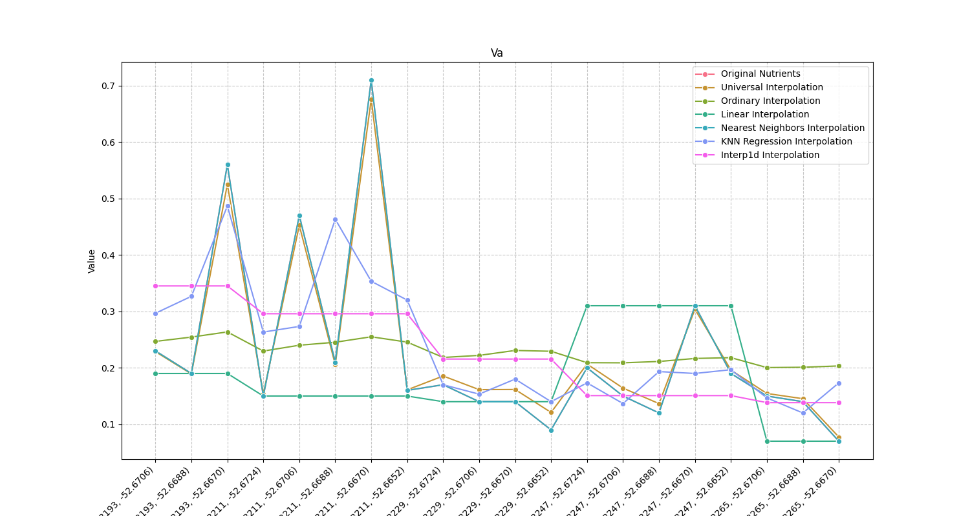
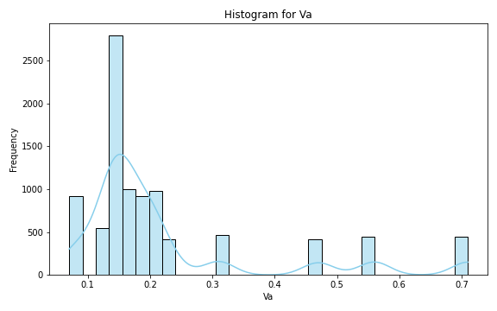
Analysis for column: Va Model: UK
Interpolated Statistics:
mean 0.228596
std 0.041876
min 0.077386
25% 0.199784
50% 0.238369
75% 0.259216
80% 0.261874
85% 0.265548
90% 0.269951
95% 0.276869
99% 0.301763
Original Statistics:
mean 0.227500
std 0.164952
min 0.070000
25% 0.140000
50% 0.165000
75% 0.215000
80% 0.246000
85% 0.334000
90% 0.479000
95% 0.567500
99% 0.681500

Slide 19
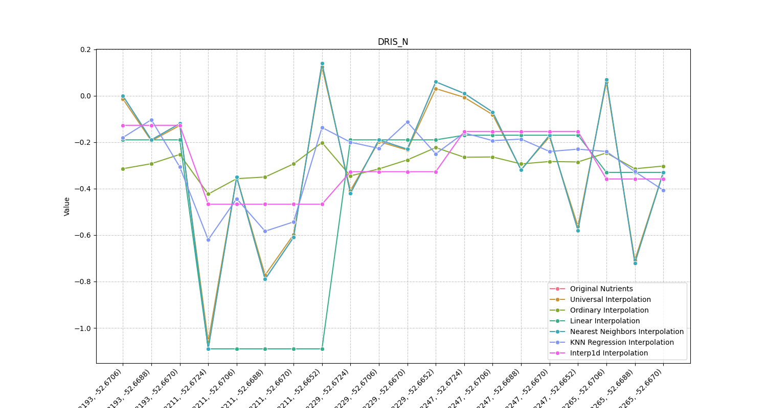
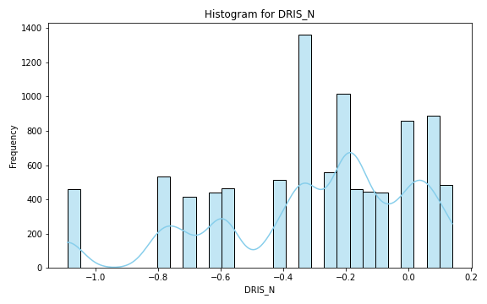
Analysis for column: DRIS_N Model: UK
Interpolated Statistics:
mean -0.296537
std 0.111981
min -1.059283
25% -0.347505
50% -0.287301
75% -0.232376
80% -0.216564
85% -0.196920
90% -0.175171
95% -0.137446
99% -0.051317
Original Statistics:
mean -0.295000
std 0.325277
min -1.090000
25% -0.460000
50% -0.210000
75% -0.052500
80% 0.002000
85% 0.017500
90% 0.061000
95% 0.073500
99% 0.126700

Slide 20
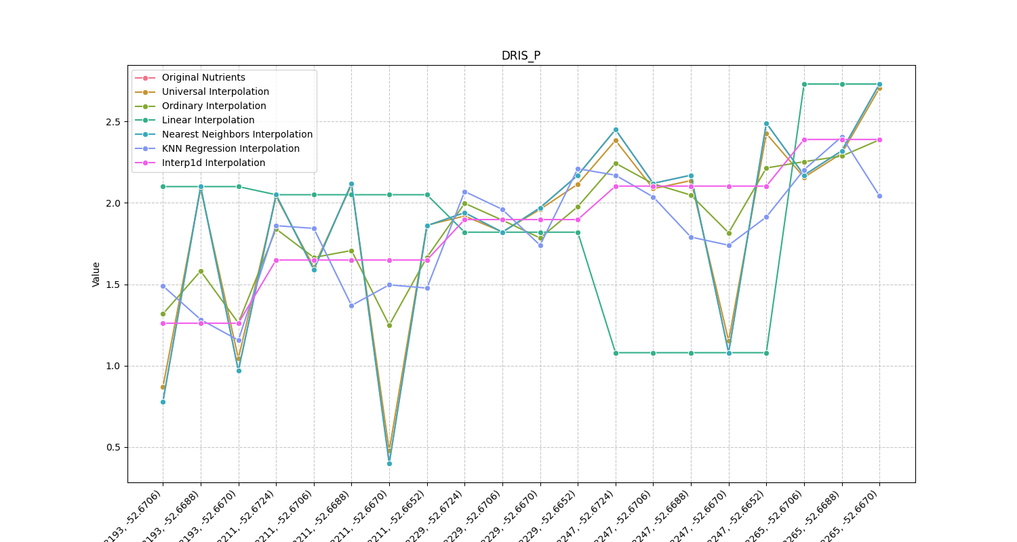
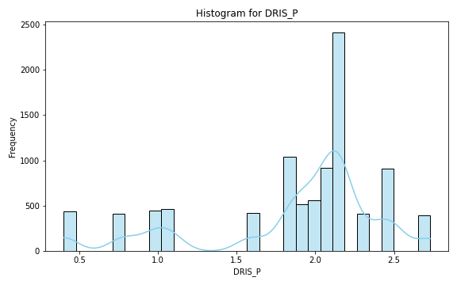
Analysis for column: DRIS_P Model: UK
Interpolated Statistics:
mean 1.865560
std 0.115648
min 0.477747
25% 1.785957
50% 1.856660
75% 1.937161
80% 1.962171
85% 1.986835
90% 2.010125
95% 2.051619
99% 2.145033
Original Statistics:
mean 1.865000
std 0.607917
min 0.400000
25% 1.762500
50% 2.075000
75% 2.170000
80% 2.200000
85% 2.339500
90% 2.454000
95% 2.502000
99% 2.684400

Slide 21
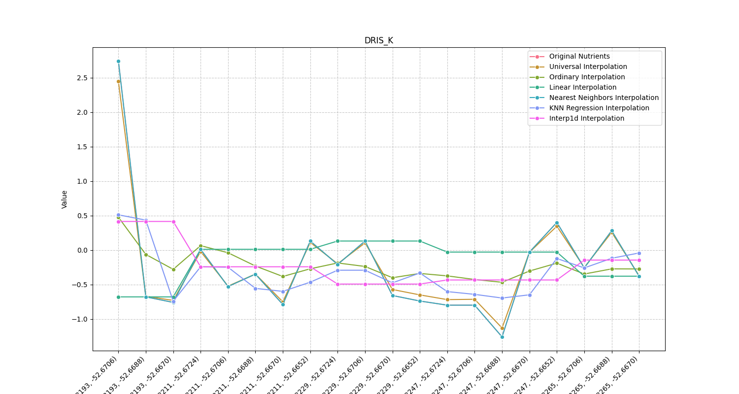
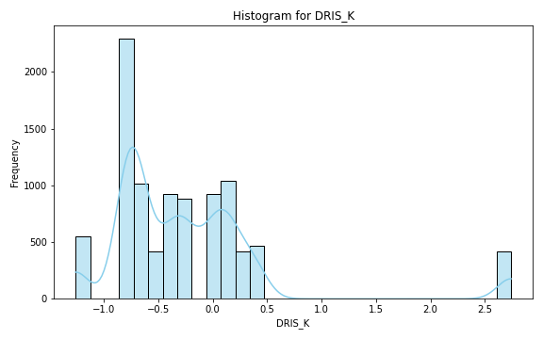
Analysis for column: DRIS_K Model: UK
Interpolated Statistics:
mean -0.219870
std 0.227069
min -1.130511
25% -0.342831
50% -0.195112
75% -0.083396
80% -0.055503
85% -0.028540
90% -0.006045
95% 0.029251
99% 0.333559
Original Statistics:
mean -0.228000
std 0.824478
min -1.260000
25% -0.745000
50% -0.365000
75% 0.040000
80% 0.130000
85% 0.152500
90% 0.292000
95% 0.517000
99% 2.295400

Slide 22
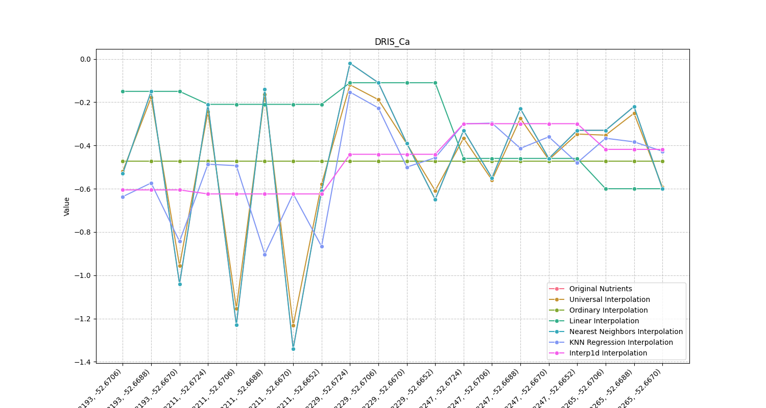
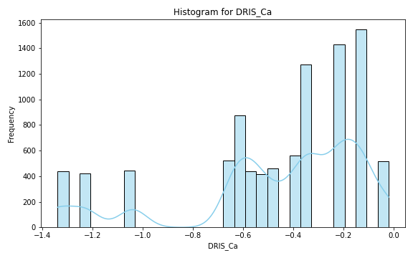
Analysis for column: DRIS_Ca Model: UK
Interpolated Statistics:
mean -0.473770
std 0.100625
min -1.232445
25% -0.547861
50% -0.477719
75% -0.404946
80% -0.383901
85% -0.360613
90% -0.331561
95% -0.305596
99% -0.262587
Original Statistics:
mean -0.473500
std 0.365229
min -1.340000
25% -0.602500
50% -0.360000
75% -0.217500
80% -0.198000
85% -0.148500
90% -0.137000
95% -0.105500
99% -0.037100

Slide 23
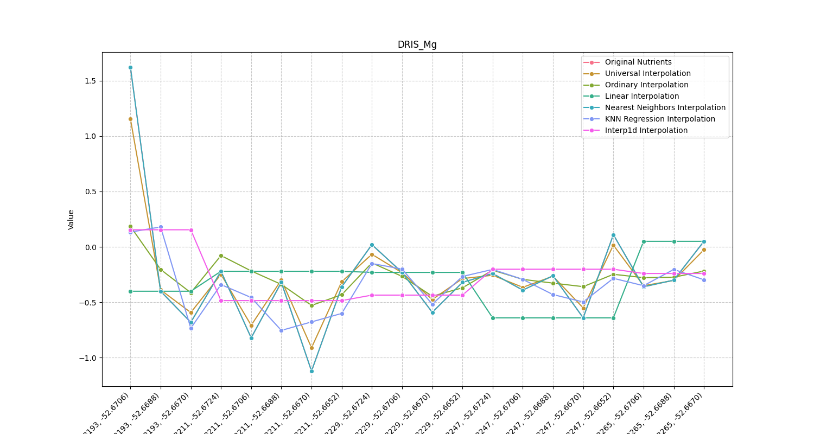
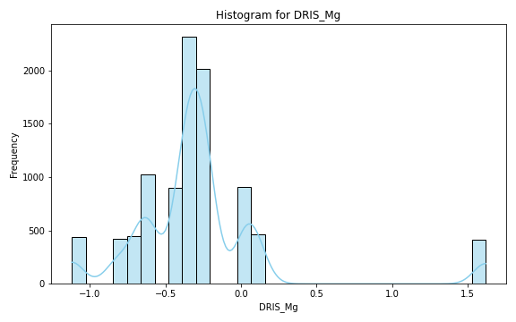
Analysis for column: DRIS_Mg Model: UK
Interpolated Statistics:
mean -0.267533
std 0.112477
min -0.909355
25% -0.313936
50% -0.280142
75% -0.223990
80% -0.208301
85% -0.187329
90% -0.164559
95% -0.135079
99% 0.138304
Original Statistics:
mean -0.272500
std 0.532807
min -1.120000
25% -0.447500
50% -0.320000
75% -0.227500
80% -0.172000
85% 0.024500
90% 0.056000
95% 0.185500
99% 1.333100

Slide 24
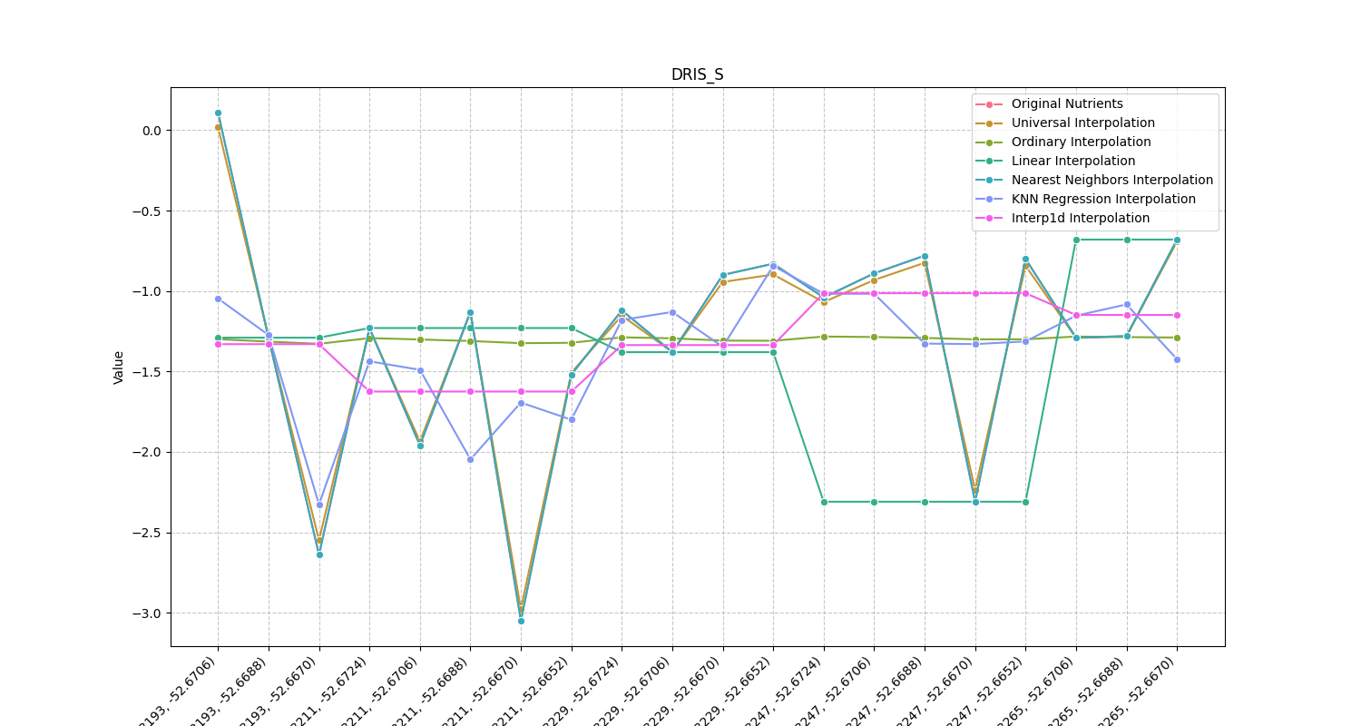
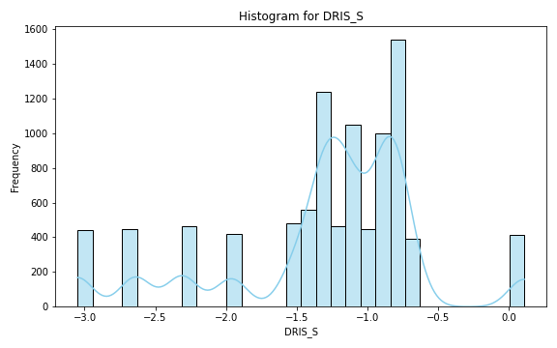
Analysis for column: DRIS_S Model: UK
Interpolated Statistics:
mean -1.300328
std 0.153961
min -2.977438
25% -1.387611
50% -1.336936
75% -1.239724
80% -1.197606
85% -1.139557
90% -1.084197
95% -1.010421
99% -0.884024
Original Statistics:
mean -1.300500
std 0.723475
min -3.050000
25% -1.415000
50% -1.180000
75% -0.875000
80% -0.824000
85% -0.797000
90% -0.770000
95% -0.640500
99% -0.040100

Slide 25
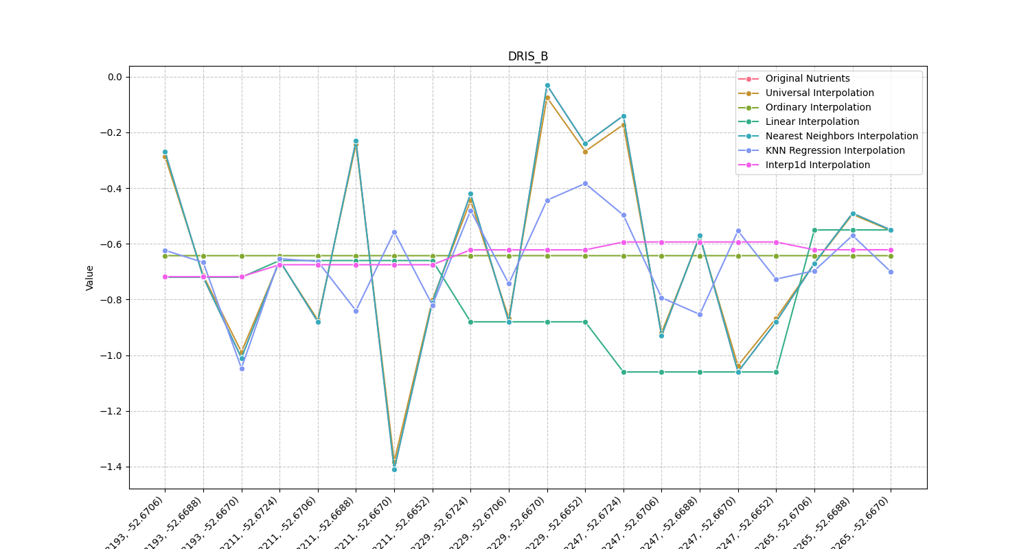
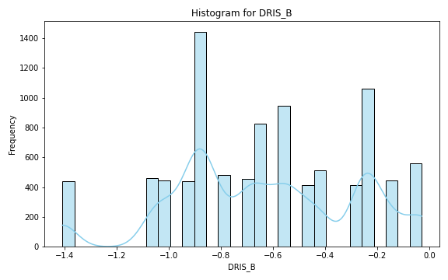
Analysis for column: DRIS_B Model: UK
Interpolated Statistics:
mean -0.642415
std 0.109144
min -1.382106
25% -0.704596
50% -0.646387
75% -0.589331
80% -0.572060
85% -0.548764
90% -0.515245
95% -0.450794
99% -0.328469
Original Statistics:
mean -0.642500
std 0.353224
min -1.410000
25% -0.880000
50% -0.665000
75% -0.382500
80% -0.264000
85% -0.238500
90% -0.221000
95% -0.134500
99% -0.050900

Slide 26


Analysis for column: DRIS_Cu Model: UK
Interpolated Statistics:
mean -2.542473
std 0.438620
min -3.373840
25% -2.877467
50% -2.560741
75% -2.369330
80% -2.331757
85% -2.272167
90% -2.078761
95% -1.633399
99% -0.962764
Original Statistics:
mean -2.546000
std 0.661198
min -3.430000
25% -2.972500
50% -2.610000
75% -2.420000
80% -2.292000
85% -2.126500
90% -2.028000
95% -1.754000
99% -0.598800

Slide 27


Analysis for column: DRIS_Fe Model: UK
Interpolated Statistics:
mean 1.787440
std 0.486715
min -1.442738
25% 1.648161
50% 1.885275
75% 2.060449
80% 2.098820
85% 2.136239
90% 2.174048
95% 2.239424
99% 2.750897
Original Statistics:
mean 1.78800
std 2.49472
min -1.71000
25% 0.81500
50% 0.94500
75% 1.11500
80% 1.76400
85% 4.06600
90% 4.37300
95% 6.95550
99% 8.86310

Slide 28


Analysis for column: DRIS_Mn Model: UK
Interpolated Statistics:
mean 1.232495
std 0.020885
min -0.248420
25% 1.232500
50% 1.232500
75% 1.232500
80% 1.232500
85% 1.232500
90% 1.232500
95% 1.232500
99% 1.233141
Original Statistics:
mean 1.232500
std 0.571166
min -0.770000
25% 1.047500
50% 1.265000
75% 1.457500
80% 1.610000
85% 1.782000
90% 1.854000
95% 1.891500
99% 1.914300

Slide 29


Analysis for column: DRIS_Zn Model: UK
Interpolated Statistics:
mean 0.465087
std 0.473944
min -2.370921
25% 0.450758
50% 0.566133
75% 0.699076
80% 0.722833
85% 0.751755
90% 0.785455
95% 0.826126
99% 0.873443
Original Statistics:
mean 0.448500
std 0.706252
min -2.370000
25% 0.515000
50% 0.590000
75% 0.797500
80% 0.824000
85% 0.841500
90% 0.851000
95% 0.860500
99% 0.868100

Slide 30


Analysis for column: IMS Model: UK
Interpolated Statistics:
mean 0.489500
std 0.031087
min -0.217634
25% 0.489500
50% 0.489500
75% 0.489500
80% 0.489500
85% 0.489500
90% 0.489500
95% 0.489518
99% 0.500801
Original Statistics:
mean 0.489500
std 0.424419
min -0.240000
25% 0.440000
50% 0.500000
75% 0.562500
80% 0.572000
85% 0.583000
90% 0.607000
95% 0.737000
99% 1.755400

Slide 31


Analysis for column: IBN Model: UK
Interpolated Statistics:
mean 12.069127
std 1.078305
min 1.690114
25% 11.588198
50% 12.217174
75% 12.510529
80% 12.594285
85% 12.681948
90% 12.790655
95% 13.165956
99% 15.413703
Original Statistics:
mean 12.084000
std 3.777432
min 1.190000
25% 10.797500
50% 11.860000
75% 12.907500
80% 13.248000
85% 13.701000
90% 15.449000
95% 18.054000
99% 20.850800

